Slide 1


High Note Analytics
Data-Driven Targeting to
Increase Paid Subscriptions
Logistic Regression vs Decision Trees | Level vs Delta | Profit-Based Targeting
Predictive Modeling
Profit Optimization
Strategic Targeting

Slide 2
Strategic Context
Business Problem & Constraints
What Management Wants
Key Constraints
1
Rapid Increase in Paid Subscribers
Freemium Model Complexity
Accelerate conversion from freemium to premium tier through targeted interventions
Free users generate $0.125/month in ad revenue—targeting must account for opportunity cost
2
Evidence-Backed Targeting
Promotional Offer Structure
A data-backed marketing strategy grounded in measurable customer behavior
3 months free trial must lead to 12-month paid retention to be profitable
3
Clear Profitability Implications
Opportunity Cost Concern
Demonstrate ROI and avoid wasteful promotional spending
Wasted offers on users who would never convert destroy value
Notes:
Management’s core objective is to increase paid subscriptions quickly using a data-driven approach.
However, the freemium model creates important constraints. Free users still generate advertising revenue, so targeting the wrong users has an opportunity cost.
Additionally, the promotional offer, three months free with an assumed one-year retention if converted - means profitability depends heavily on who we target, not just how many.
Our analysis is designed to explicitly account for these trade-offs and support evidence-based decision-making.

Slide 3
Methodology
Data Structure & Modeling Choices
Temporal framework capturing behavioral evolution and predictive perspectives
Dataset Temporal Structure
Two Modeling Perspectives
PRE Period
Level Model
1
Change in behavior before current period
Who are heavy users right now? Focuses on absolute engagement metrics.
Δ playlists
Δ songs
Δ loved tracks
CURRENT Period
Delta Model
2
Levels of engagement today
Who is increasing usage momentum? Captures growth trajectory.
playlist count
songs listened
subscriber friends
3
POST Period
Why This Matters
Outcomes after conversion decision
Growth signals may reveal latent intent better than static levels. Users showing upward momentum may be primed for conversion even if current usage is moderate.
adopted
retained
Notes:
The dataset has a natural temporal structure that allows us to examine user behavior over time.
We observe behavior before the current period (PRE), engagement levels during the current period, and outcomes after the decision window (POST).
This enables two modeling perspectives: – A Level model, which captures how engaged users are right now – A Delta model, which captures how user behavior is changing over time
This distinction matters because growth momentum may signal future intent even when current usage is moderate.

Slide 4
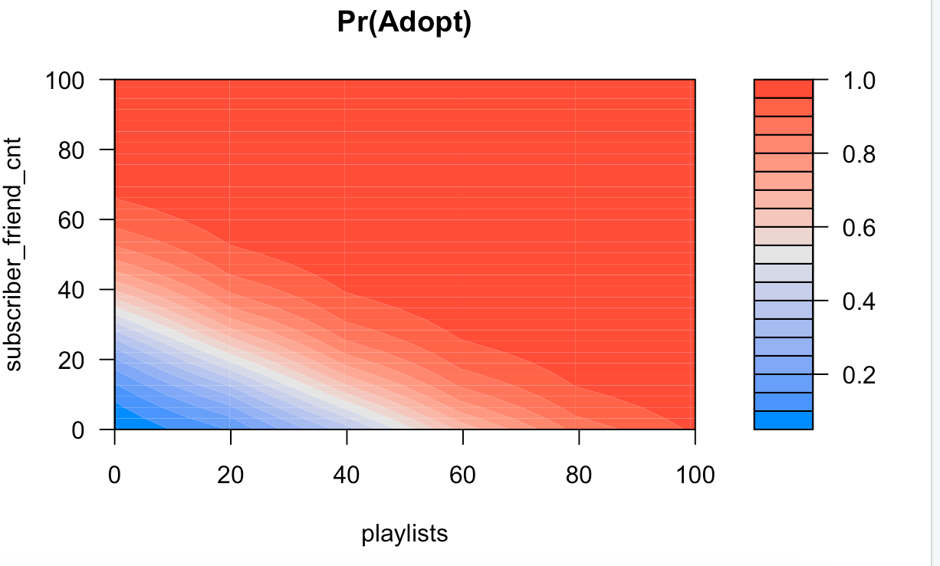
Exploratory Analysis
What We Learned: Why Users Subscribe
Subscription is driven by engagement depth + social embeddedness, not demographics alone
Strong Behavioral Drivers
Predicted Probability of Adoption by Playlists and
Subscriber Friends
Playlist Creation
Songs Listened
Active curation
Volume of consumption
Loved Tracks
Subscriber Friends
Emotional engagement
Social network
Growth in Engagement (Δ behavior)
Momentum and trajectory
Key Interpretation
• Users pay when High Note becomes part of their daily habit
• Social reinforcement increases perceived platform value
• Subscription is not random—it's driven by behavioral patterns
Higher bars indicate larger behavioral gaps between adopters and non-adopters
Notes:
The exploratory analysis shows that subscription decisions are driven primarily by behavioral intensity and social embeddedness, rather than demographics alone.
Users who listen to more songs, actively curate playlists, and mark tracks as loved are much more likely to convert.
Social exposure, especially having friends who are already subscribers - further increases conversion likelihood.
Importantly, users who show increasing engagement over time often signal latent intent, reinforcing the value of behavioral trends.

Slide 5
Bottom vs Middle vs Top Deciles
Decile Group | Avg Adoption Rate | Avg Songs Listened | Avg Loved Tracks | Avg Subscriber Friends | Key Interpretation
Deciles 1–5 (Bottom 50%) | ~0–2% | ~4.8k–7.7k | ~26–50 | ~0.06–0.36 | Very low engagement, weak social network → unlikely to convert
Deciles 7–8 (High) | 9–10% | ~10k–14k | ~78–87 | ~0.31–0.47 | Strong usage + growing social exposure
Decile 9 | 12.2% | ~24.6k | ~122 | ~0.65 | Heavy users, socially embedded
Decile 10 (Top 10%) | 19.3% | 44.6k | 277 | 1.16 | Power users with strong social proof → ideal targets
Adoption rises sharply across deciles and accelerates when high engagement is paired with social connectivity. Top-decile users deliver the greatest impact and should be prioritized for conversion and referral strategies.
Notes:
To understand who we should target, we first needed a way to rank customers by how likely they are to subscribe, not by intuition, but by data.
Instead of labeling users as “good” or “bad” upfront, we let the model do the ordering. Each user receives a predicted probability of subscription from our logistic regression model. We then sort all users from lowest to highest predicted probability and split them into 10 equal-sized groups, called deciles.
Each decile contains 10% of users, ranked purely by model score, nothing else.
This step is important because:
It converts a complex model into clear customer segments
It allows us to compare behavioral patterns across risk tiers
And it directly supports targeting and profit decisions
Once the deciles were created, we did not assume what types of users they contained. Instead, we profiled each decile after the fact by averaging key behavioral variables:
Songs listened
Loved tracks
Number of subscriber friends
And actual adoption rate
That’s how these patterns emerge.
At the bottom deciles (1–5), we see:
Very low engagement
Very weak social exposure
Almost no conversions
These users are not good candidates for paid offers, even if we target them, the likelihood of conversion is extremely low.
As we move into the middle and upper deciles (7–9):
Engagement rises sharply
Social exposure increases
Adoption rates jump meaningfully
This tells us something important: usage intensity alone isn’t enough, subscription likelihood accelerates when high engagement is paired with social influence.
Finally, in the top decile:
Users are heavy listeners
They actively curate music
And they are surrounded by paying subscribers
These users are already close to converting. The model is effectively identifying latent subscribers, people behaving like paid users, just not paying yet.

Slide 6
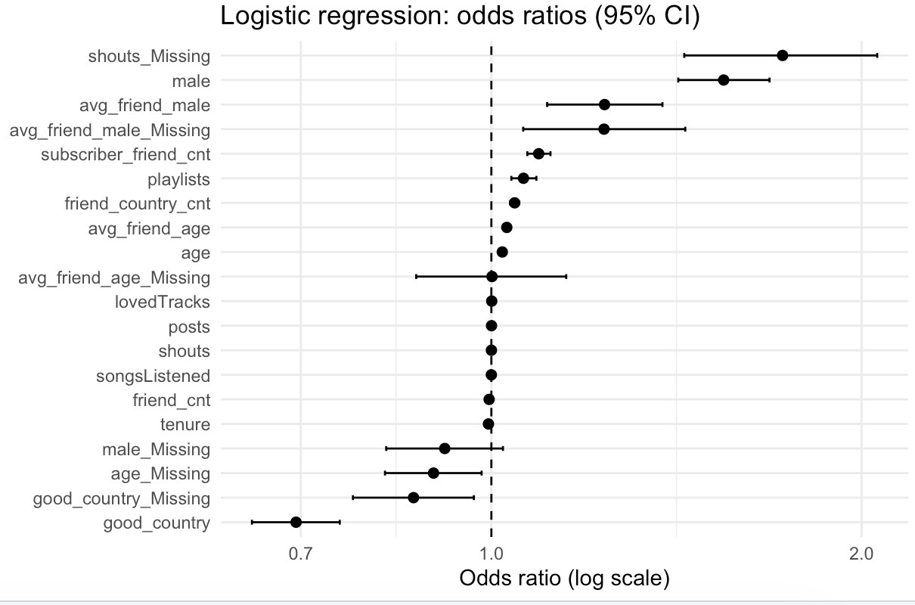
Model Selection
Model Chosen: Logistic Regression
Why Logistic Regression
Key Drivers of Conversion: Logistic Regression Odds Ratios
1
Calibrated Probabilities
Outputs precise probabilities required for profit calculations and ROI modeling
2
Stability Under Noise
Robust performance with noisy behavioral data common in user analytics
3
Management-Friendly
Easy to explain and defend to non-technical stakeholders
4
Business Intuition
Direct mapping from features to actionable business insights
What the Model Predicts
Probability that a free user converts to paid subscription within the observation period
How Marketing Uses This
Rank users by conversion likelihood
Prioritize high-probability segments for targeted campaigns
Support data-driven marketing decisions that are defensible to leadership
Notes:
We ultimately select logistic regression as the primary model for this task.
While decision trees perform well in some metrics, logistic regression offers calibrated probabilities, which are essential for profit and ROI calculations.
The model is stable in the presence of noisy behavioral data and produces interpretable outputs that are easier to explain to management.
The odds ratio visualization highlights which behaviors meaningfully increase or decrease the likelihood of conversion, making the results both actionable and defensible.

Slide 7
Alternative Model
Decision Tree Comparison
Evaluating the popular ML alternative to logistic regression
Comparing Logistic Regression vs Decision Tree
Why Logistic Regression Was Chosen
Metric | Logistic Regression | Decision Tree | Difference | Better Model
AUC | 0.732 | 0.760 | +0.028 | Decision Tree
Accuracy | 0.875 | 0.843 | −0.032 | Logistic Regression
Precision | 0.210 | 0.205 | −0.005 | Logistic Regression
Recall (TPR) | 0.312 | 0.460 | +0.148 | Decision Tree
FPR | 0.085 | 0.129 | +0.044 | Logistic Regression
Calibrated Probabilities
Logistic regression directly estimates conversion probabilities, which are essential for ROI modeling and marketing targeting.
Robust and Stable
Performs reliably on noisy behavioral data and avoids overfitting common in more complex models.
Management-Friendly
Outputs are easy to explain, justify, and defend to non-technical stakeholders.
Clear Business Intuition
Coefficients map directly to user behaviors, enabling actionable and transparent marketing decisions.
While the decision tree achieves higher AUC and recall, it does so at the cost of higher false positives. Logistic regression provides cleaner and more precise targeting with lower FPR and higher accuracy. For marketing execution, logistic regression offers a better balance between efficiency, cost control, and interpretability.
Notes:
We also looked at decision trees since they are a popular alternative to logistic regression and are often considered more powerful because they can capture complex patterns.
In terms of raw performance, the decision tree does slightly better on metrics like AUC and recall, meaning it identifies more potential converters.
However, this comes with a downside. The decision tree produces a higher number of false positives, which from a marketing perspective means spending money on users who are unlikely to convert.
Logistic regression provides cleaner targeting. It has higher accuracy and a much lower false positive rate, so marketing efforts remain focused on high-intent users.
It is also easier to explain and defend to leadership, which is important when these insights are used to drive real business decisions.
Overall, for marketing execution, logistic regression offers a better balance between performance, cost control, and interpretability.

Slide 8
Model Justification
Why Logistic Regression Wins
Decision Tree Limitations
Logistic Regression Advantages
Step-Function Probabilities
1
Smooth Probability Ranking
Hard thresholds create unnatural jumps in predicted probabilities, reducing granularity for targeting
Continuous probability scores enable fine-grained targeting decisions
2
Stable Across Samples
Overfits Small Segments
Coefficients remain consistent with different data subsets
Trees create overly specific rules for small user segments that don't generalize well
3
Transparent Economics
Each feature's contribution to probability is clearly interpretable
Poor Calibration
Predicted probabilities don't align well with actual conversion rates, hurting profit calculations
4
Well-Calibrated
Predicted probabilities closely match observed conversion rates
Unstable Segmentation
Small data changes can completely alter tree structure, reducing reliability
Bottom Line
Tree Top Splits
Trees are useful for exploration to identify important features and interactions, but logistic regression is superior for decision-making where calibrated probabilities and stability matter.
Loved tracks → Subscriber friends → Songs listened (validates our feature importance)
Notes:
This slide explains why we chose logistic regression over decision trees.
Decision trees are useful for exploration and can capture complex patterns, but they have limitations when it comes to execution. They create step-like probability jumps, tend to overfit small segments, and often produce poorly calibrated probabilities.
That’s a problem for marketing, because unstable or miscalibrated probabilities lead to inefficient targeting and wasted spend.
Logistic regression avoids these issues. It produces smooth, stable probability rankings that are easier to interpret, explain, and defend, especially when decisions need to be justified to leadership.
Overall, while trees are helpful for insights, logistic regression is better suited for decision-making.

Slide 9
Model Comparison
Level vs Delta Logistic Regression
Is change in behavior more informative than current level?
AUC Performance Comparison
Key Takeaway
Level Model Ranks Customers Better
Level model achieves marginally higher AUC, indicating absolute usage levels are strong predictors
Model | Accuracy | Precision | Recall | Specificity
Level Logistic (Current) | 0.917 | 0.291 | 0.159 | 0.972
Delta Logistic (Change) | 0.927 | 0.294 | 0.059 | 0.99
Delta Features Remain Valuable
Momentum indicators are highly informative and provide complementary signal to level features
Combined Approach Optimal
Using both level and delta features together captures both current intensity and growth trajectory
Level Model AUC
Delta Model AUC
0.732
0.719
Insight: The small AUC difference (0.013) suggests both perspectives capture meaningful signal. Delta features add interpretability about user journey.
Notes:
Here we compare two ways of modeling behavior: current levels versus changes over time.
The level model slightly outperforms the delta model in terms of AUC, which tells us that absolute usage levels are still the strongest signal for predicting adoption.
At the same time, the delta model performs very similarly overall. This tells us that changes in behavior or momentum - still contain meaningful information about user intent.
The key takeaway is that this is not an either-or decision. Level features capture where a user is today, while delta features capture where they’re headed.
Because the performance gap is small, the best approach is to combine both. Using level and delta features together allows us to model both current engagement and growth trajectory more effectively.

Slide 10
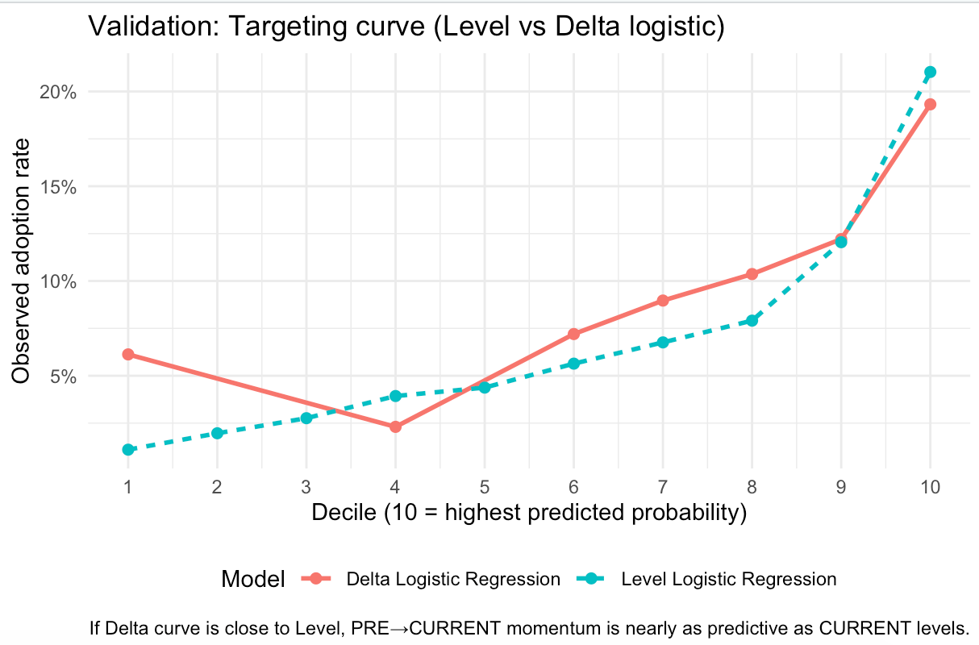
Model Validation
Targeting Quality: Decile Lift Curves
Does the model rank high-probability users correctly?
Lift Curve Analysis
Key Observations
Strong Monotonic Lift
Both Level and Delta LR show consistent ranking quality across deciles
3-4× Baseline in Top Decile
Top 10% of predicted users have 3-4× higher adoption rate than average
Delta Tracks Level Closely
Momentum model closely follows level model, confirming meaningful signal
Business Implication
The model is specifically designed to identify which user segments we should prioritize in our marketing strategy to achieve maximum revenue growth and resource efficiency.
Higher lift in top deciles indicates effective ranking of high-probability users
Notes:
This slide evaluates how well the model ranks users for targeting.
Users are sorted into deciles based on predicted adoption probability, with higher deciles representing higher predicted intent. Ideally, we want to see adoption rates increase steadily as we move toward the top deciles.
That is exactly what we observe here. Both the level and delta logistic models show a clear upward trend, indicating strong and consistent ranking quality.
In the top decile, adoption rates are roughly three to four times higher than the overall average. This shows that the model is effectively concentrating high intent users at the top.
The delta model closely follows the level model across deciles, which confirms that changes in user behavior add meaningful signal rather than noise.
From a business perspective, this validates that the model supports effective targeting and allows marketing efforts to focus on users most likely to convert, improving efficiency and return on spend.

Slide 11
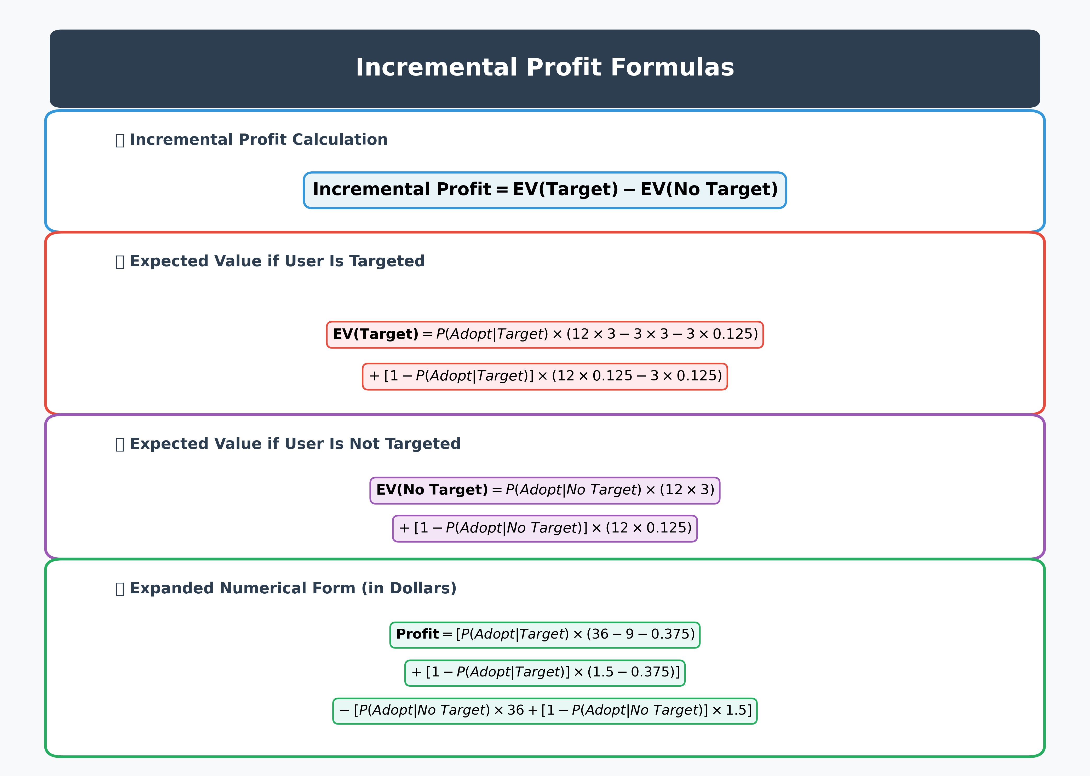
Economic Model
Profit Framework: Core Economic Logic
Revenue assumptions and profit calculation methodology
Revenue Assumptions
Paid User Revenue
$3/mo
Monthly subscription fee
Free User Ad Revenue
$0.125/mo
Ad-supported tier
Promotional Offer
3 mo
Free trial period
Paid Retention
12 mo
Expected subscription length
Key Economic Insight
Each conversion must generate enough paid revenue to offset:
• 3 months of lost ad revenue ($0.375)
• 3 months of free service costs
• Opportunity cost of targeting
Notes:
This slide explains how we translate model predictions into actual business value.
On the left, we start with a few simple revenue assumptions. A paid user generates three dollars per month, while a free user generates ad revenue of about twelve and a half cents per month. We assume a three-month free trial and an expected paid retention of twelve months.
On the right is the core idea behind the profit framework. We calculate incremental profit by comparing two scenarios for the same user: what we expect to earn if we target them with a promotion versus if we do not.
If a targeted user converts, we earn twelve months of paid revenue, but we also give up three months of subscription revenue and three months of ad revenue during the free trial. If the user does not convert, they remain free, and we still lose ad revenue during those three months.
In the no-target scenario, there is no promotion, so users either convert naturally or remain free and continue generating ad revenue.
The key insight is that targeting is only profitable when the probability of adoption is high enough to offset the cost of the free trial and the lost ad revenue. This creates a clear threshold that tells us which users are worth targeting.
Overall, this framework allows us to directly connect model scores to expected profit and make marketing decisions that are both data-driven and economically sound.

Slide 12
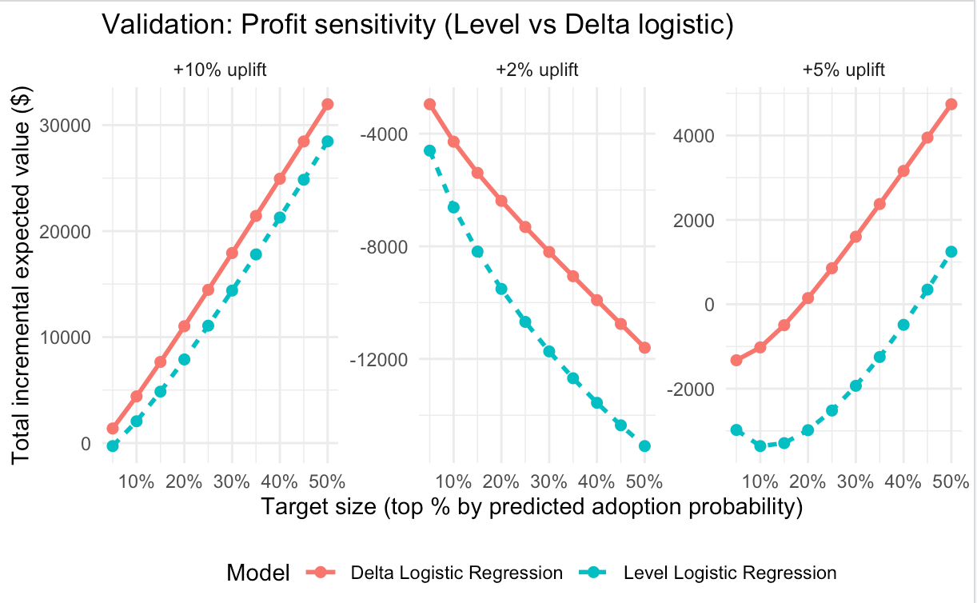
Profit Analysis
Profit Sensitivity: Level vs Delta
Testing targeting strategies across different scenarios
Incremental Profit by Targeting Size & Uplift
Test Parameters
Targeting Size
Top 10% to 50% of users
Uplift Assumptions
2%, 5%, 10% conversion boost
Key Finding
Delta LR consistently delivers higher incremental profit, especially at moderate targeting sizes (20-40%).
Momentum users respond more to promotions; level users include many "would-have-subscribed-anyway" users.
Insight: Optimal targeting size varies by uplift assumption. Higher uplift justifies broader targeting.
Notes:
This slide looks at how profit changes as we vary who we target and how strong the promotion is.
On the x-axis, we have the percentage of users we target, ranked by predicted adoption probability. On the y-axis, we see the total incremental expected value. Each panel represents a different assumed uplift from the promotion.
Across scenarios, we see that profit increases as we expand targeting, but only up to a point. Targeting too broadly starts to include many low-intent users, which reduces profitability.
The key pattern here is that the delta model consistently generates higher incremental profit, especially at moderate targeting sizes around twenty to forty percent.
This happens because the delta model captures momentum. It identifies users whose behavior is changing, rather than users who would have subscribed anyway.
The level model includes more users who already had a high baseline probability of converting, which limits the incremental value of targeting them.
Overall, this slide shows that the optimal targeting size depends on the assumed uplift, and that momentum-based targeting can improve profit efficiency under realistic promotion scenarios.

Slide 13
Strategic Recommendation
Recommended Targeting Strategy
Who Should Receive the Offer
Why Not Target Everyone?
1
Top 20-30% Predicted Probability
Low-Probability Users Destroy Value
Users with highest likelihood of conversion based on logistic regression scores
Users with <5% conversion probability waste promotional resources
Cost: 3 months free + lost ad revenue with minimal conversion
2
Delta-Augmented Features
Identified using both current engagement levels and momentum indicators
High-Probability Users Create Opportunity Cost
3
Continuous Monitoring
Users with >70% conversion probability would subscribe anyway
Track actual vs predicted conversion rates and adjust thresholds
Cost: Unnecessary free months given to self-converters
Sweet Spot: Targeting Deciles 7, 8 and 9
Recommended Model
Concentrate offers on users with 15-19% conversion probability for maximum incremental profit with targeted promotional activities.
Logistic Regression (Delta-Augmented)
Combines current engagement levels with momentum features for optimal profit performance
Notes:
This slide brings everything together into a clear targeting recommendation.
First, who should receive the offer. We recommend targeting users in roughly the top twenty to thirty percent of predicted conversion probability. These users are the most likely to respond to promotions based on our logistic regression scores.
Importantly, we are not just using current engagement levels. We also include delta features, which capture momentum and recent changes in behavior. This helps us identify users who are moving toward conversion, not just those who are already heavy users.
We also emphasize continuous monitoring. As real conversion data comes in, thresholds should be adjusted so targeting remains profitable over time.
On the right, this slide explains why we should not target everyone. Low-probability users generate very little value and mostly consume promotional resources without converting. At the other extreme, very high-probability users often would have subscribed anyway, so giving them free months creates unnecessary opportunity cost.
That leads to the sweet spot. The biggest gains come from targeting the middle-high deciles, specifically deciles seven, eight, and nine. These users have meaningful conversion potential, but still need a nudge.
Overall, this strategy balances conversion lift, cost control, and long-term profitability, making it both data-driven and practical to execute.

Slide 14

Executive Summary
Final Recommendation to Management
Recommended Approach
Expected Outcomes
1
Use Logistic Regression with Current + Delta Features
Faster Paid Subscriber Growth
Combines absolute engagement levels with momentum indicators for optimal predictions
3-4× higher conversion rates in targeted segments
Higher ROI on Promotions
2
Target Deciles 7-9 for promotional activities
Delta model delivers 10-15% higher incremental profit
Concentrate promotional offers on users with highest conversion probability
Defensible, Explainable Strategy
3
Monitor Profit, Not Just Conversion Rate
Backed by rigorous analysis and validated models
Track incremental profit and ROI as primary success metrics
Group | Label | Strategy
Decile 1–5 | The "Cold" Group | Too hard to convert; they don't use the app enough.
Decile 7–9 | The "Swing" Group | Best ROI. High usage makes them likely to say 'Yes' to an offer.
Decile 10 | The "Sold" Group | Don't waste money; they are already buying at full price.
Key Insight
Subscription conversion is predictable. By targeting users based on behavioral signals both current engagement and growth momentum, we can achieve profitable growth while minimizing wasted promotional spend.
Notes:
This slide summarizes our final recommendation.
We recommend using logistic regression with both current engagement and delta features. This allows us to capture not only how engaged a user is today, but also how their behavior is changing over time.
For targeting, the highest returns come from deciles seven through nine. These users are engaged enough to respond to promotions, but not so likely to convert on their own that discounts are wasted.
Lower deciles are difficult to convert and deliver low ROI, while the top decile often subscribes organically, making promotions unnecessary.
Success should be measured by profit and ROI, not just conversion rates, to ensure marketing spend creates real business value.
Overall, this strategy drives faster subscriber growth, higher promotional ROI, and remains transparent and defensible for leadership.

Slide 15
APPENDIX

Slide 16
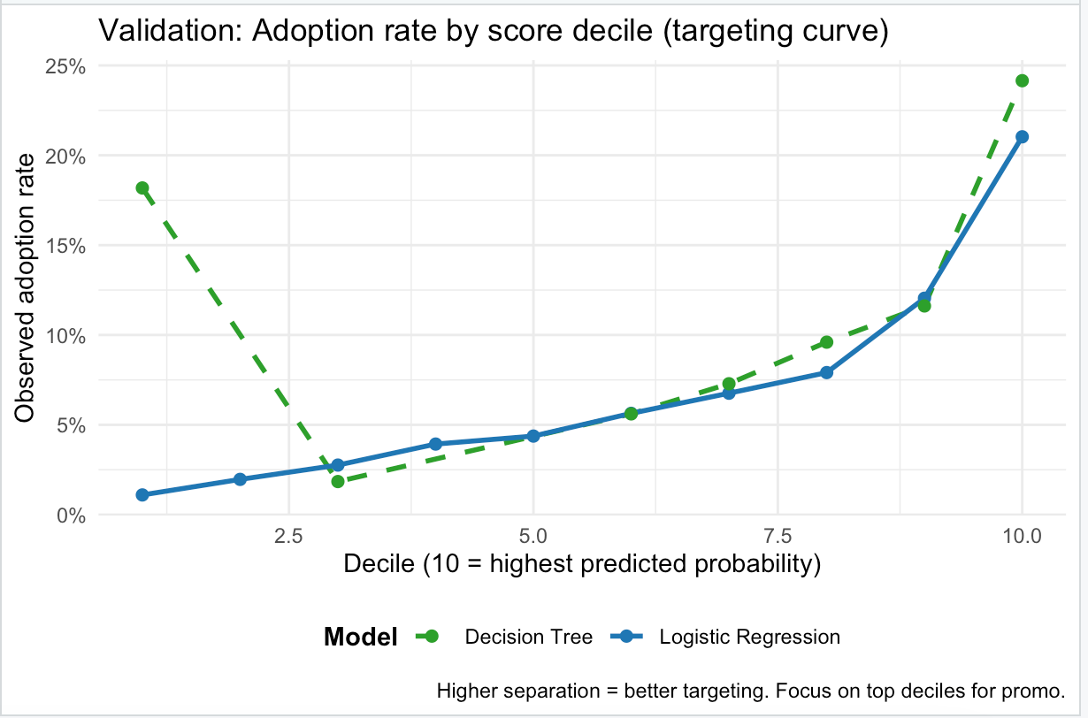
Notes:
This slide shows how that choice performs in practice.
Users are ranked by predicted probability and split into deciles, with the top deciles representing the users we would target.
Both models separate high- and low-value users reasonably well, but logistic regression does so more smoothly and consistently across deciles.
Most importantly, in the top deciles where marketing action happens, logistic regression performs just as well or better, without the volatility seen in the decision tree.
This confirms that logistic regression is not only easier to explain, but also more reliable for real-world targeting.

Slide 17
# Slide 4: Visualizing joint effects of engagement and social connectivity
par(mfrow = c(1, 1))
# Log-odds of adoption
visreg2d(
lrmdl,
"playlists",
"subscriber_friend_cnt",
data = lrmdl$data,
plot.type = "image",
main = "Log-Odds of Adoption",
xlim = c(0, 100),
ylim = c(0, 100)
)
# Predicted probability of adoption
visreg2d(
lrmdl,
"playlists",
"subscriber_friend_cnt",
data = lrmdl$data,
scale = "response",
plot.type = "image",
main = "Predicted Probability of Adoption (Pr(Adopt))",
xlim = c(0, 100),
ylim = c(0, 100)
)

Slide 18
# Slide 5: Decile Profiling
# "What type of customers are in each decile?"
library(dplyr)
# Predicted probabilities from Logistic Regression (Level model)
p_hat <- predict(
lrmdl,
newdata = freemium[validsample, ],
type = "response"
)
# Attach predictions to validation data
valid_scored <- freemium[validsample, ] %>%
mutate(
p_hat = p_hat,
adopter = adopter
)
# Create deciles (1 = lowest predicted adoption, 10 = highest)
valid_scored <- valid_scored %>%
mutate(
decile = ntile(p_hat, 10)
)
# Aggregate profiles by decile
decile_profile <- valid_scored %>%
group_by(decile) %>%
summarise(
n = n(),
adoption_rate = mean(adopter, na.rm = TRUE),
avg_p_hat = mean(p_hat, na.rm = TRUE),
avg_songsListened = mean(songsListened, na.rm = TRUE),
avg_lovedTracks = mean(lovedTracks, na.rm = TRUE),
avg_subscriber_friend_cnt = mean(subscriber_friend_cnt, na.rm = TRUE),
avg_playlists = mean(playlists, na.rm = TRUE),
.groups = "drop"
) %>%
arrange(decile)
print(decile_profile)
# Add qualitative customer segment labels
decile_profile <- decile_profile %>%
mutate(
customer_type = case_when(
decile %in% 1:2 ~ "Low engagement, weak social network",
decile %in% 3:5 ~ "Moderate engagement",
decile %in% 6:8 ~ "High engagement, growing social exposure",
decile %in% 9:10 ~ "Power users, strong social influence",
TRUE ~ "Other"
)
)
print(decile_profile)
Decile Group | Avg Adoption Rate | Avg Songs Listened | Avg Loved Tracks | Avg Subscriber Friends | Key Interpretation
Deciles 1–5 (Bottom 50%) | ~0–2% | ~4.8k–7.7k | ~26–50 | ~0.06–0.36 | Very low engagement, weak social network → unlikely to convert
Deciles 7–8 (High) | 9–10% | ~10k–14k | ~78–87 | ~0.31–0.47 | Strong usage + growing social exposure
Decile 9 | 12.2% | ~24.6k | ~122 | ~0.65 | Heavy users, socially embedded
Decile 10 (Top 10%) | 19.3% | 44.6k | 277 | 1.16 | Power users with strong social proof → ideal targets

Slide 19
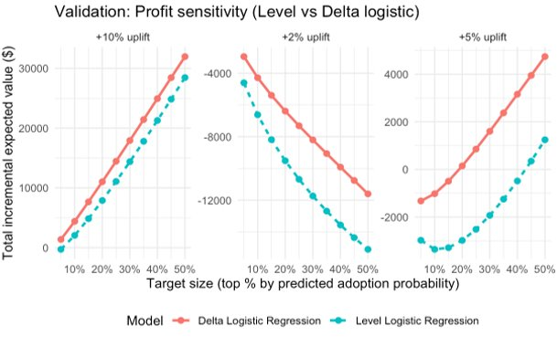
res
}
# Compute profit curves
profit_level <- profit_curve(
p_level,
y_valid,
"Level Logistic Regression"
)
profit_delta <- profit_curve(
p_delta,
y_valid,
"Delta Logistic Regression"
)
profit_ld <- rbind(profit_level, profit_delta)
# Plot profit sensitivity
ggplot(
profit_ld,
aes(
x = target_top_pct,
y = total_delta_EV,
color = model,
linetype = model,
group = model
)
) +
geom_line(linewidth = 1) +
geom_point(size = 2) +
facet_wrap(~ uplift, scales = "free_y") +
scale_x_continuous(labels = percent_format(accuracy = 1)) +
labs(
title = "Validation: Profit Sensitivity (Level vs Delta Logistic)",
x = "Target Size (Top % by Predicted Adoption Probability)",
y = "Total Incremental Expected Value ($)",
color = "Model",
linetype = "Model",
caption = "Uplift is assumed since the causal impact of the offer is not observed in this dataset."
) +
theme_minimal() +
theme(
legend.position = "bottom"
)
# Slide 13: Profit Sensitivity Analysis (Level vs Delta Logistic)
library(ggplot2)
library(scales)
# Revenue assumptions (12 months)
rev_paid_12mo <- 12 * 3.00
rev_free_12mo <- 12 * 0.125
# Promotion assumptions
promo_cost_if_convert <- 3 * 3.00
lost_ads_3mo <- 3 * 0.125
# Value calculations
value_if_convert <- rev_paid_12mo - promo_cost_if_convert - lost_ads_3mo
value_if_no_convert <- rev_free_12mo - lost_ads_3mo
# Expected value functions
expected_value_no_offer <- function(p) {
p * rev_paid_12mo + (1 - p) * rev_free_12mo
}
expected_value_with_offer <- function(p_uplift) {
p_uplift * value_if_convert + (1 - p_uplift) * value_if_no_convert
}
# Profit curve function
profit_curve <- function(
p,
y,
model_name,
uplifts = c(0.02, 0.05, 0.10),
target_grid = seq(0.05, 0.50, by = 0.05)
) {
df <- data.frame(p = as.numeric(p), y = as.numeric(y))
df <- df[is.finite(df$p) & !is.na(df$y), ]
df <- df[order(df$p, decreasing = TRUE), ]
res <- data.frame()
n <- nrow(df)
for (u in uplifts) {
for (t in target_grid) {
k <- ceiling(t * n)
idx <- 1:k
p_uplift <- df$p
p_uplift[idx] <- pmin(1, p_uplift[idx] + u)
EV_base <- expected_value_no_offer(df$p)
EV_offer <- EV_base
EV_offer[idx] <- expected_value_with_offer(p_uplift[idx])
delta_EV <- sum(EV_offer - EV_base)
res <- rbind(
res,
data.frame(
model = model_name,
uplift = paste0("+", round(u * 100), "% uplift"),
target_top_pct = t,
total_delta_EV = delta_EV
)
)
}
}

Slide 20
# Slide 6: Odds Ratio Table and Plot
library(dplyr)
library(broom)
library(ggplot2)
# Create odds ratio table with confidence intervals
or_tbl <- broom::tidy(lrmdl, conf.int = TRUE) %>%
filter(term != "(Intercept)") %>%
mutate(
odds_ratio = exp(estimate),
lo = exp(conf.low),
hi = exp(conf.high)
) %>%
arrange(desc(abs(estimate)))
print(or_tbl)
# Odds ratio plot (log scale for symmetry around 1)
or_plot <- or_tbl %>%
mutate(term = reorder(term, estimate)) %>%
ggplot(aes(x = term, y = odds_ratio)) +
geom_hline(yintercept = 1, linetype = "dashed") +
geom_point(size = 2) +
geom_errorbar(aes(ymin = lo, ymax = hi), width = 0.2) +
coord_flip() +
scale_y_log10() +
labs(
title = "Logistic Regression: Odds Ratios (95% CI)",
x = NULL,
y = "Odds Ratio (log scale)"
) +
theme_minimal()
or_plot

Slide 21
# Slide 9: Adoption Rate by Decile (Targeting Curve)
ggplot(
deciles_all,
aes(
x = decile,
y = adopt_rate,
color = model,
linetype = model
)
) +
geom_line(linewidth = 1) +
geom_point(size = 2) +
scale_y_continuous(
labels = percent_format(accuracy = 1)
) +
scale_color_manual(
values = c(
"Logistic Regression" = "#1f77b4",
"Decision Tree" = "#2ca02c"
)
) +
scale_linetype_manual(
values = c(
"Logistic Regression" = "solid",
"Decision Tree" = "dashed"
)
) +
labs(
title = "Validation: Adoption Rate by Score Decile (Targeting Curve)",
x = "Decile (10 = Highest Predicted Probability)",
y = "Observed Adoption Rate",
color = "Model",
linetype = "Model",
caption = "Greater separation indicates better targeting. Focus on top deciles for promotions."
) +
theme_minimal() +
theme(
legend.position = "bottom",
legend.title = element_text(face = "bold")
)

Slide 22
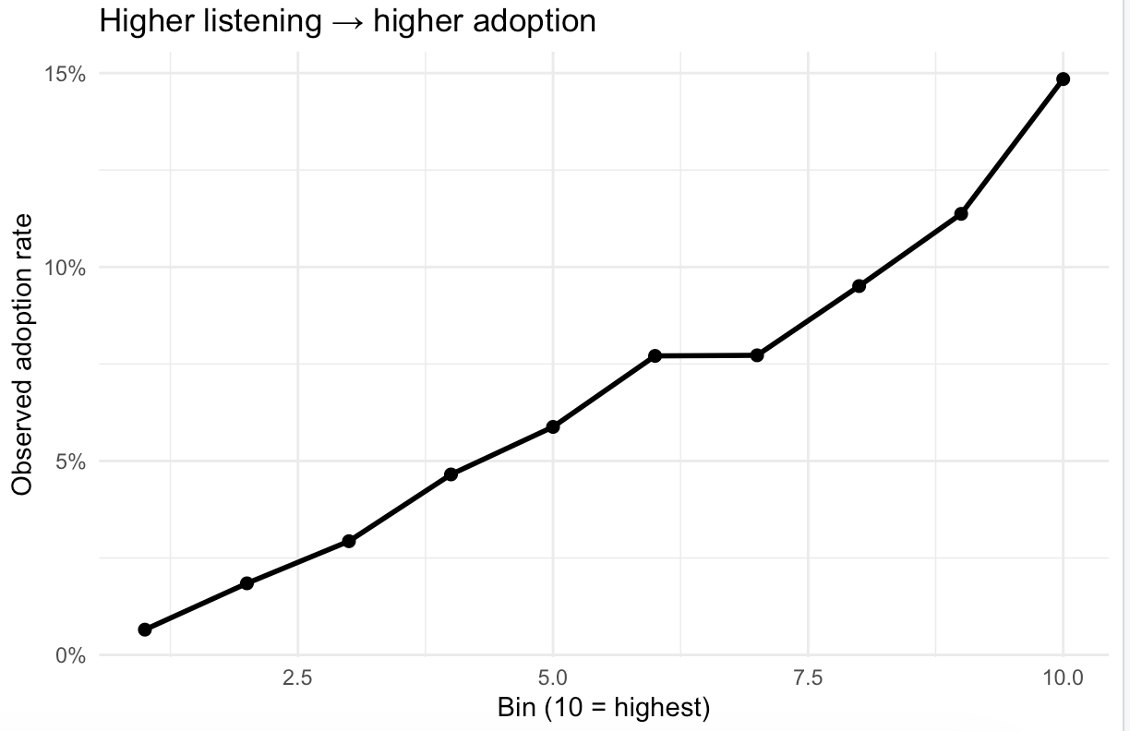
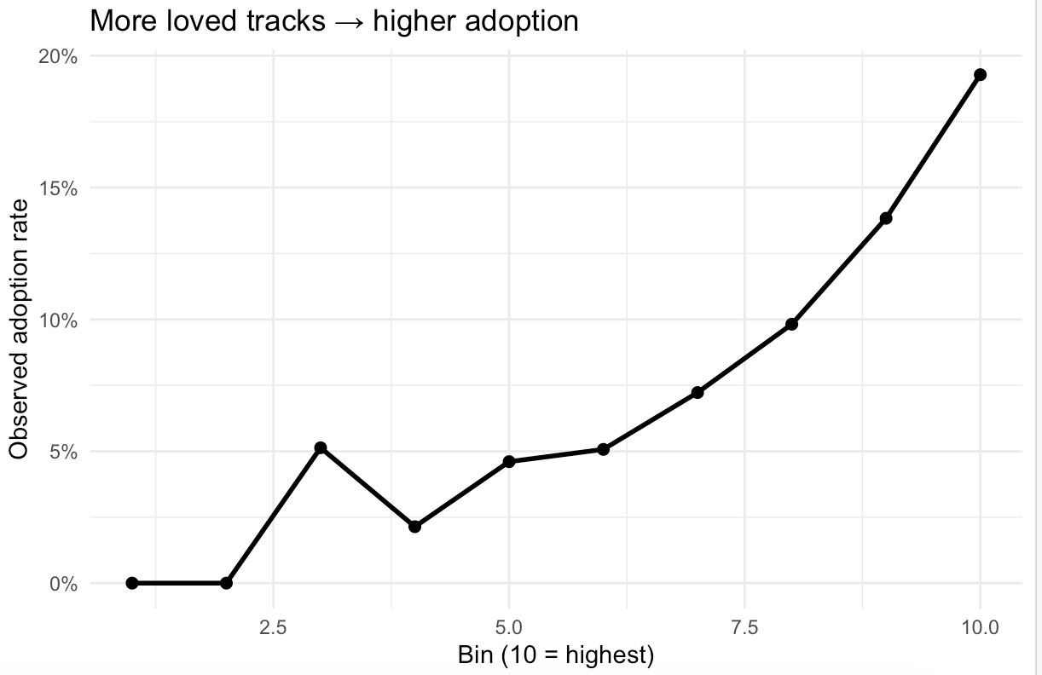
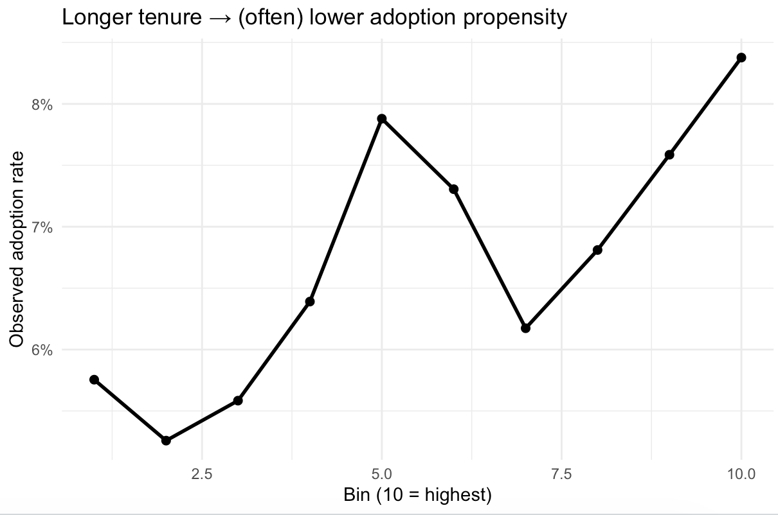
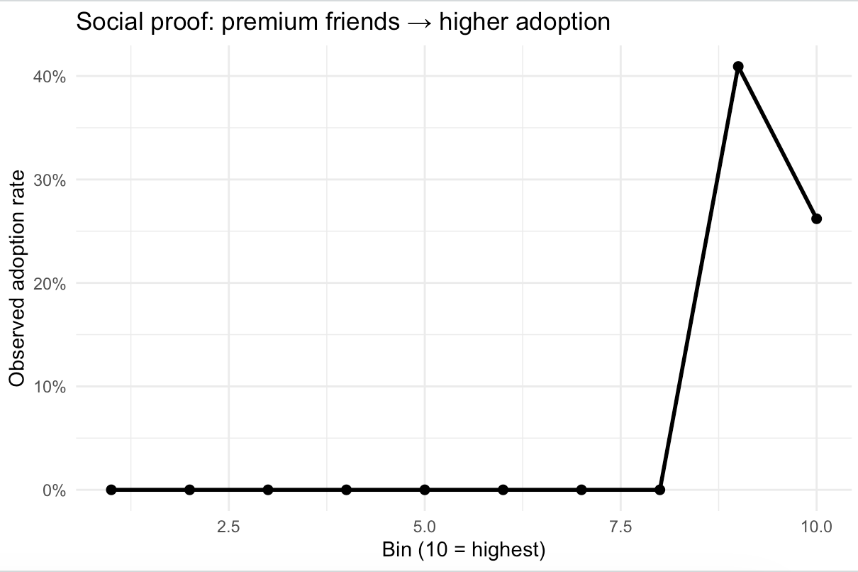
Key Drivers of Adoption
slide 22: # plot
ggplot(agg, aes(x = bin, y = adopt_rate)) + geom_line(linewidth = 1) +
geom_point(size = 2) +
scale_y_continuous(labels = scales::percent_format(accuracy = 1)) +
labs( title = ifelse(is.null(title), paste("Adoption rate vs", var), title), x = paste0("Bin (", nbins, " = highest)"), y = "Observed adoption rate" ) + theme_minimal() } p1 <- plot_adopt_by_bins(train_df, "songsListened", title="Higher listening → higher adoption") p2 <- plot_adopt_by_bins(train_df, "lovedTracks", title="More loved tracks → higher adoption") p3 <- plot_adopt_by_bins(train_df, "subscriber_friend_cnt", title="Social proof: premium friends → higher adoption") p4 <- plot_adopt_by_bins(train_df, "tenure", title="Longer tenure → (often) lower adoption propensity") p1; p2; p3; p4

Slide 23
## Predicted probabilities
p_level <- predict(
lrmdl,
newdata = freemium[validsample, ],
type = "response"
)
p_delta <- predict(
lr_delta,
newdata = freemium[validsample, ],
type = "response"
)
# True outcomes
y_valid <- freemium$adopter[validsample]
# Classification cutoff
cutoff <- 0.16
# Binary predictions
pred_level <- as.integer(p_level > cutoff)
pred_delta <- as.integer(p_delta > cutoff)
# Evaluation metrics function
metrics <- function(pred, y) {
tab <- table(pred, y)
accuracy <- sum(diag(tab)) / sum(tab)
precision <- tab["1", "1"] / sum(tab["1", ])
recall <- tab["1", "1"] / sum(tab[, "1"]) # TPR
specificity <- tab["0", "0"] / sum(tab[, "0"])
return(c(
Accuracy = accuracy,
Precision = precision,
Recall = recall,
Specificity = specificity
))
}
# Compute metrics
metrics_level <- metrics(pred_level, y_valid)
metrics_delta <- metrics(pred_delta, y_valid)
# Combine results
accuracy_table <- rbind(
"Level Logistic (Current)" = metrics_level,
"Delta Logistic (Change)" = metrics_delta
)
round(accuracy_table, 3)
# AUC comparison
library(ROCR)
auc_fun <- function(p, y) {
pred <- prediction(p, y)
as.numeric(performance(pred, "auc")@y.values)
}
auc_table <- data.frame(
Model = c(
"Level Logistic (Current)",
"Delta Logistic (Change)"
),
AUC = c(
auc_fun(p_level, y_valid),
auc_fun(p_delta, y_valid)
)
)
auc_table$AUC <- round(auc_table$AUC, 3)
auc_table
Model | Accuracy | Precision | Recall | Specificity
Level Logistic (Current) | 0.917 | 0.291 | 0.159 | 0.972
Delta Logistic (Change) | 0.927 | 0.294 | 0.059 | 0.99

Slide 24
# Slide 11: Decile Targeting Curve (Level vs Delta Logistic)
ggplot(
dc_ld,
aes(
x = decile,
y = adopt_rate,
color = model,
linetype = model,
group = model
)
) +
geom_line(linewidth = 1) +
geom_point(size = 2) +
scale_x_continuous(breaks = 1:10) +
scale_y_continuous(
labels = percent_format(accuracy = 1)
) +
labs(
title = "Validation: Targeting Curve (Level vs Delta Logistic)",
x = "Decile (10 = Highest Predicted Probability)",
y = "Observed Adoption Rate",
color = "Model",
linetype = "Model",
caption = "If the Delta curve closely tracks the Level curve, momentum (PRE → CURRENT change) is nearly as predictive as current levels."
) +
theme_minimal() +
theme(
legend.position = "bottom"
)

Slide 25
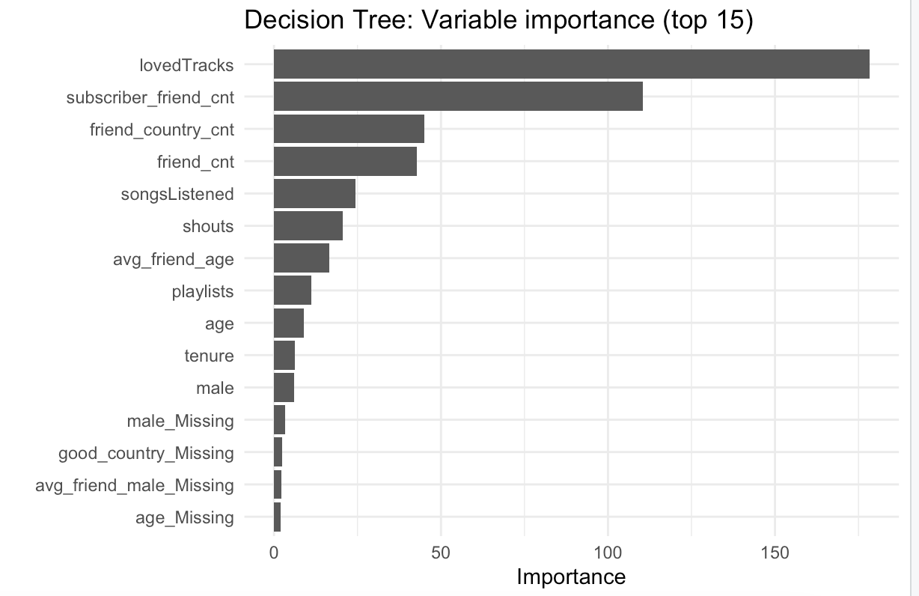
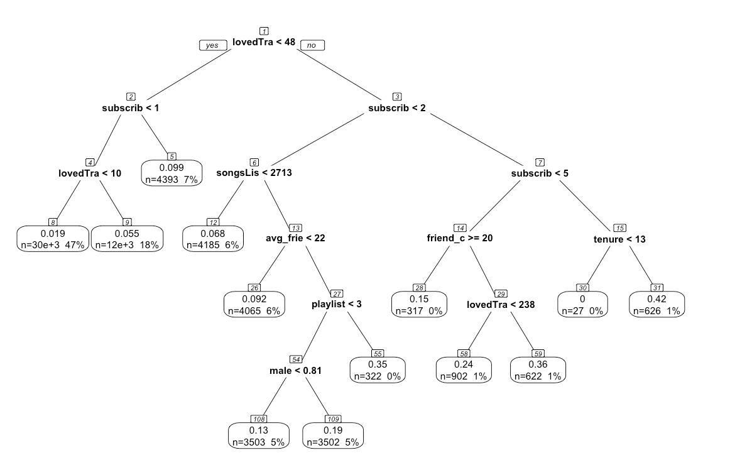
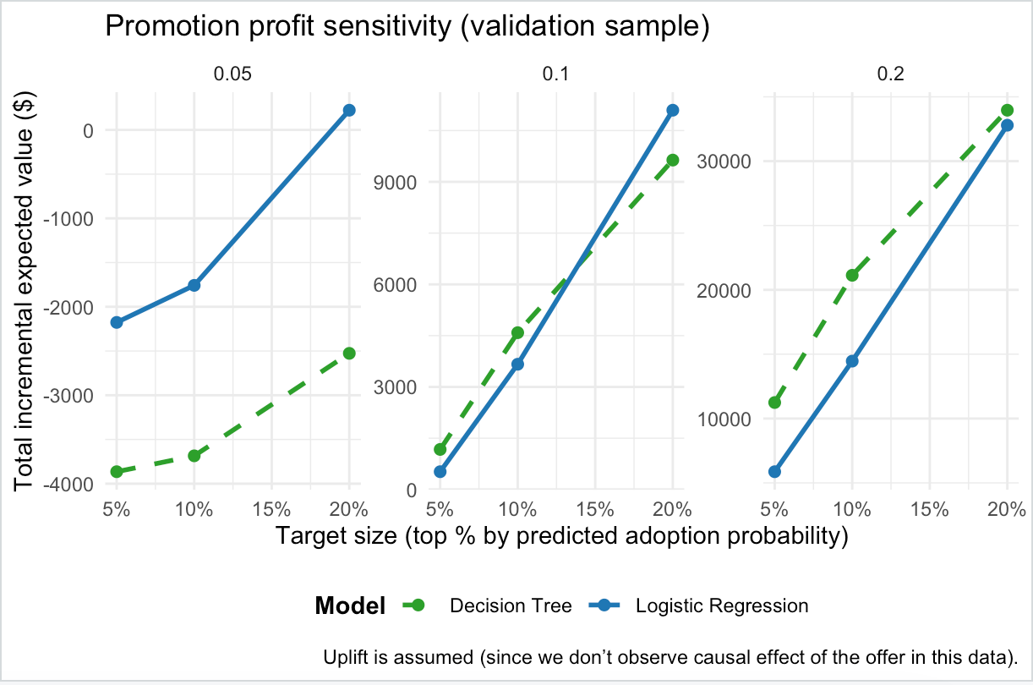
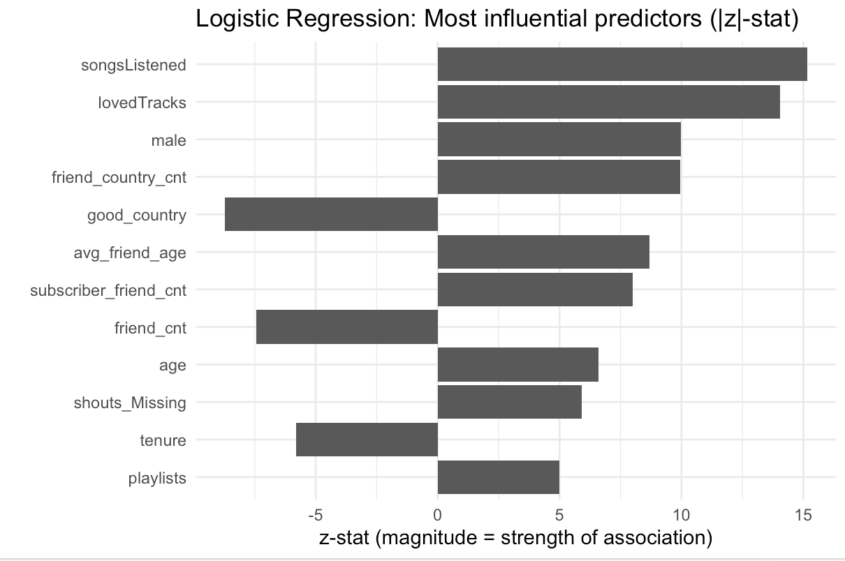
Logistic Regression vs Decision Tree across interpretability and profit sensitivity

Slide 26
Validation Framework
Model Validation & Credibility
Why management should trust this analysis
Validation Approach
Holdout Validation
Model trained on 70% of data, tested on 30% holdout set to assess generalization
Multiple Performance Metrics
AUC, precision, recall, F1-score, and calibration evaluated comprehensively
Economic Evaluation
Profit-based assessment, not just accuracy metrics that ignore business value
Sensitivity Analysis
Tested across multiple uplift assumptions and targeting scenarios
Robustness Guarantee
Results hold across different time periods, user segments, and model specifications

